Slide 1
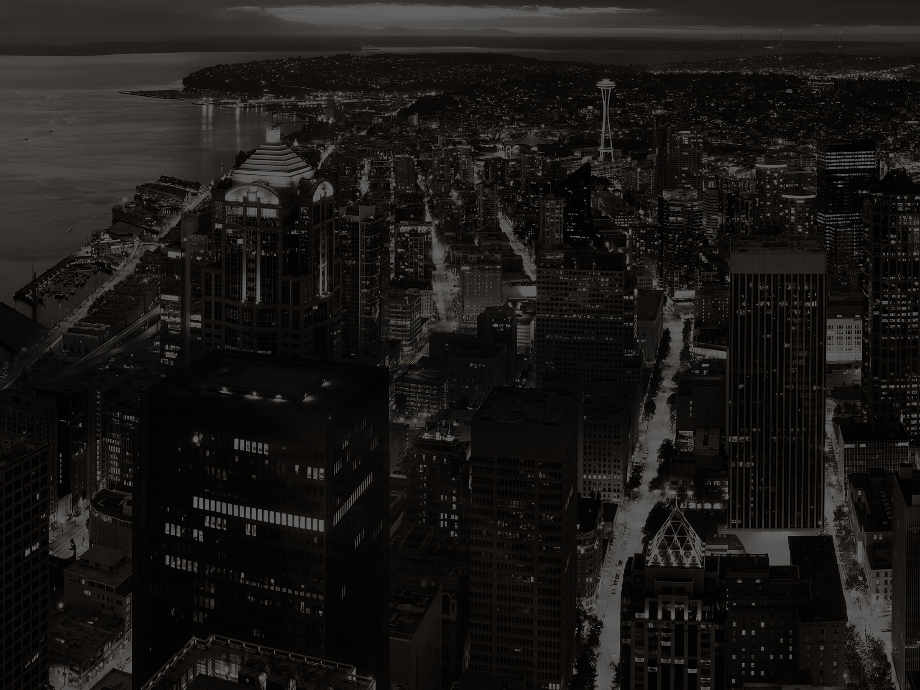



Slide 2



Slide 3
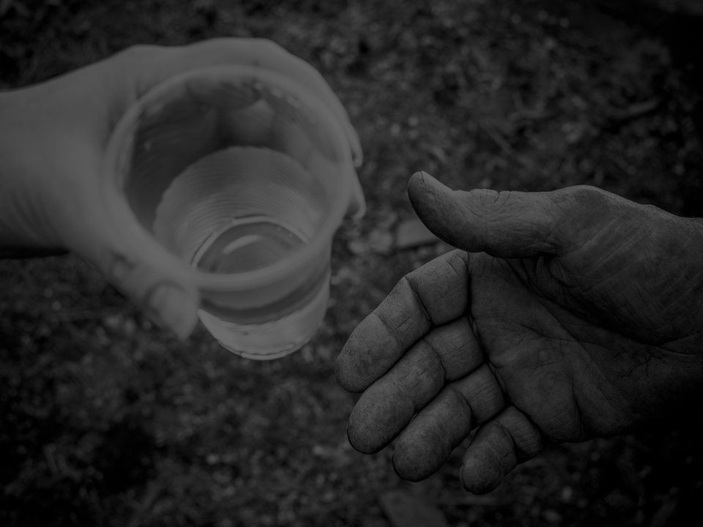

MISSION
To bring the love of Jesus and hope for
a new life to our homeless neighbors

Slide 4
VISION
Every homeless neighbor—beloved, redeemed, restored
But God is so rich in mercy, and He loved us so much, that even though we were dead because of our sins, He gave us life when He raised Christ from the dead. (It is only by God’s grace that you have been saved!) EPHESIANS 2:4-5 (NLT)

Slide 5


Graduation slides

Slide 6
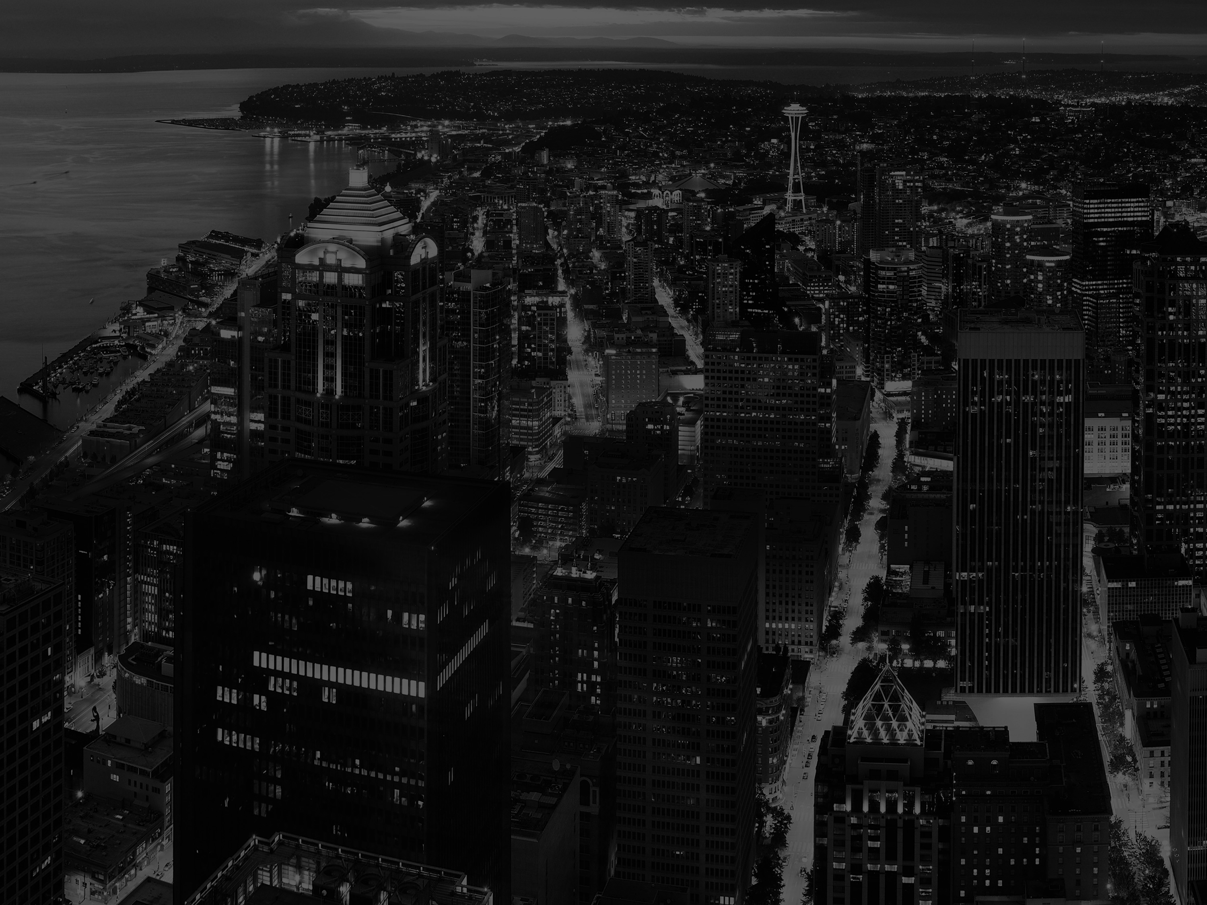
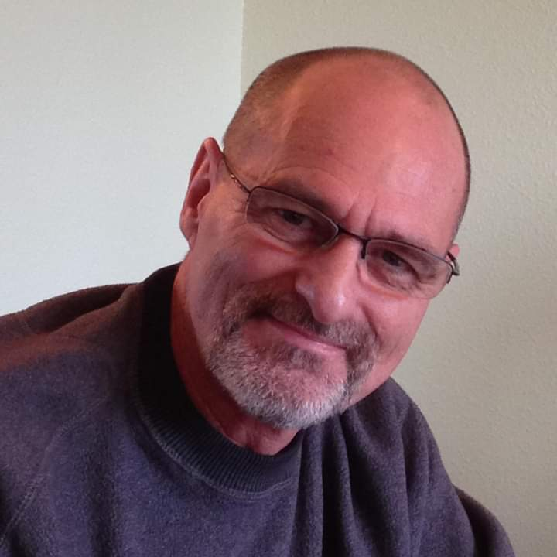

Welcome
Graduation slides
Scott Cleveland
Director of the Men’s Recovery Program

Slide 7

HEADLINE
Recap
  Background/Highlights
  Financial Results

Slide 8

HEADLINE (logo lower right)
Recap
  Background/Highlights
  Financial Results

Slide 9
HEADLINE (no logo)
Recap
  Background/Highlights
  Financial Results

Slide 10
Optional background – small logo only

Slide 11

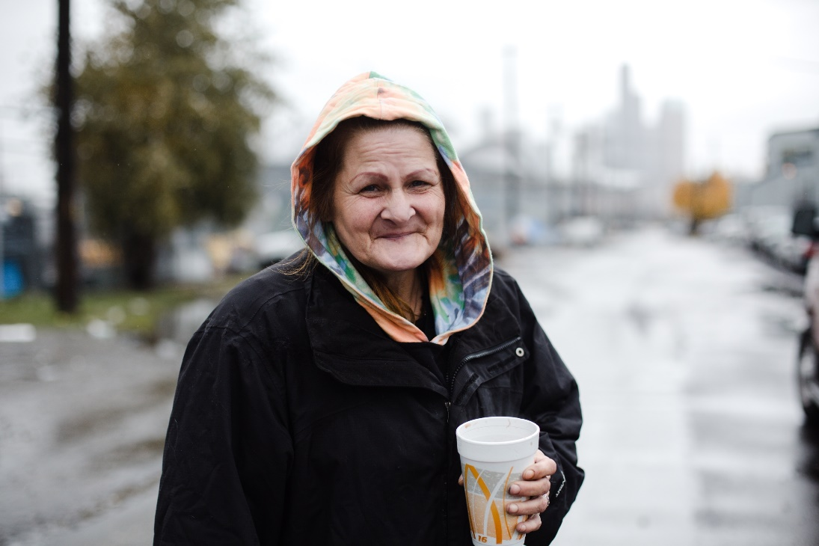
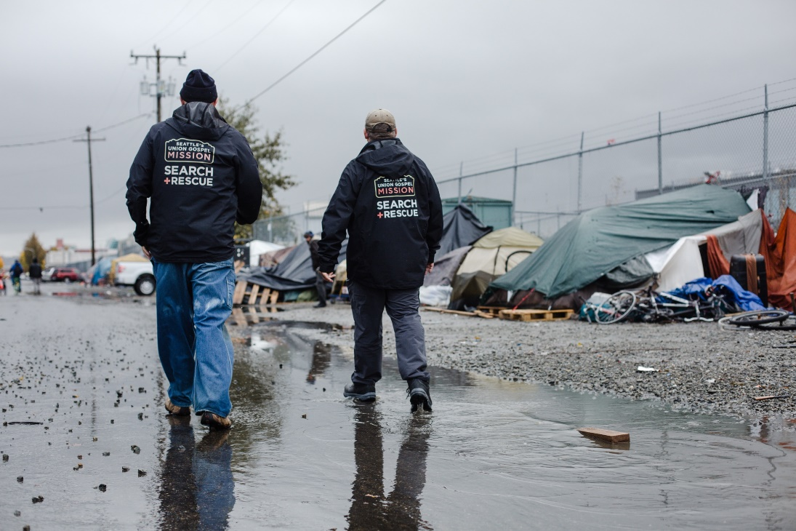
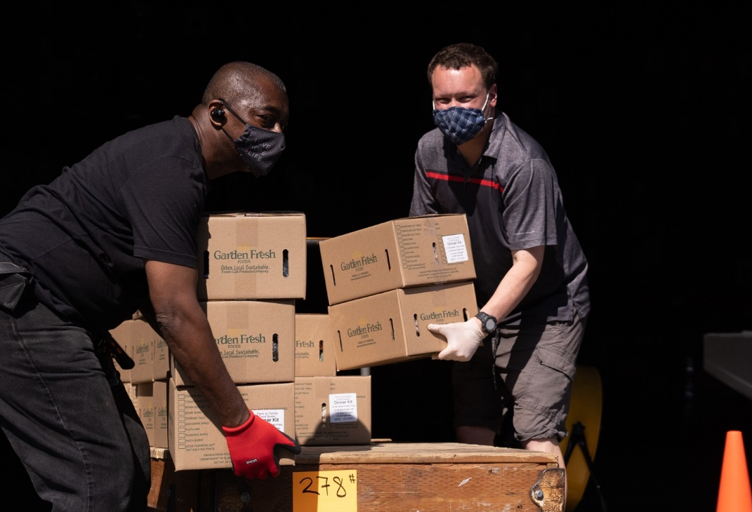
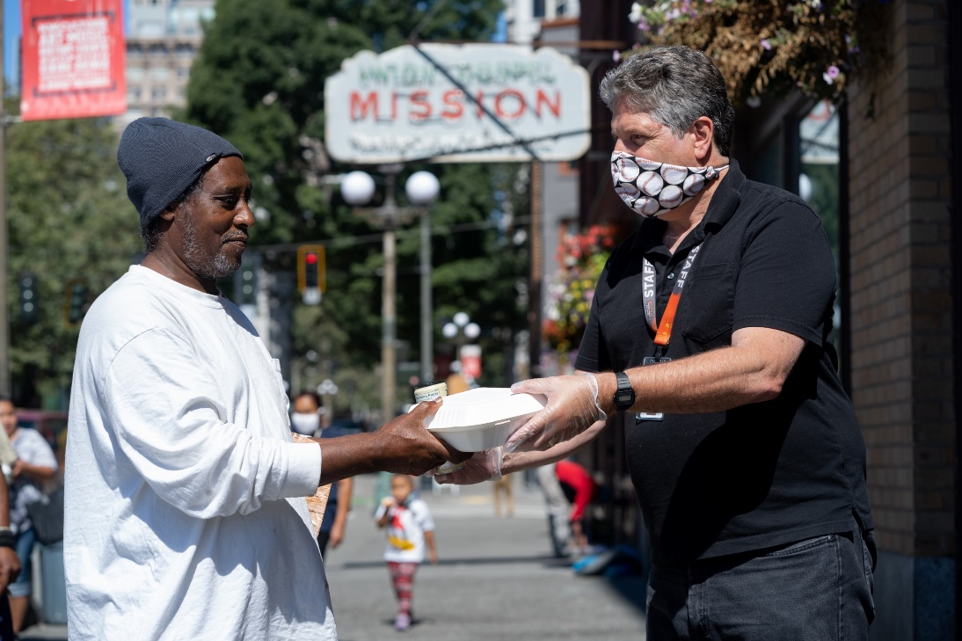
Collage example:
Please keep logo on page
Notes:
Objective

Slide 12
Homelessness in Seattle/King County
Chart example
Notes:
There is a crisis

Slide 13
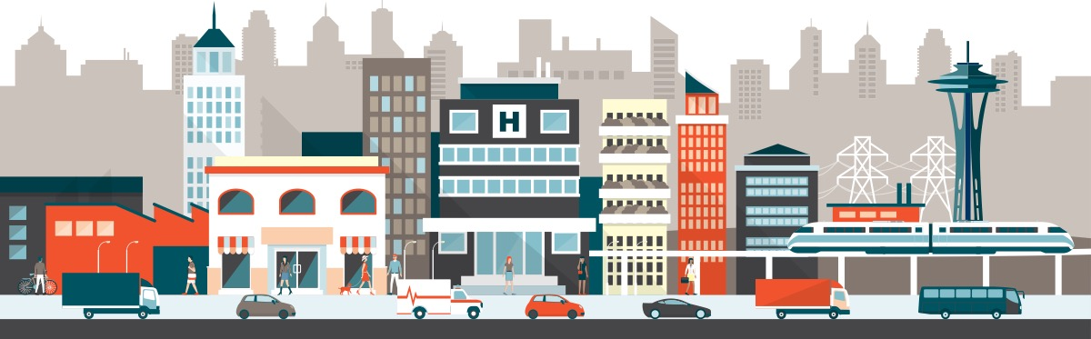
11,199 Homeless
1,500 Youth
Half are Unsheltered
Stats
example
2,241 Families
Notes:
--Size of the Crisis
The numbers are changing all of the time, but according to the 2019 Count Us In report from All Home King County:
There are 11,199 homeless people in Seattle/King County.
5,228, or about half, are unsheltered.
2,241 are families with children.
1,089 are youth and young adults.

Slide 14
“Act wisely toward outsiders, making the most of the time. Let your speech always be gracious, seasoned with salt, so that you may know how you should answer each person.”
COLOSSIANS 4:5-6 CSB
Scripture
example
Notes:
Colossians 4:5-6

Slide 15
Speaker Name
Notes:
Objective

Slide 16
Q & A

Slide 17

THANK YOU!
ugm.org

Slide 18




Follow us
@SeattlesUGM

