Slide 3
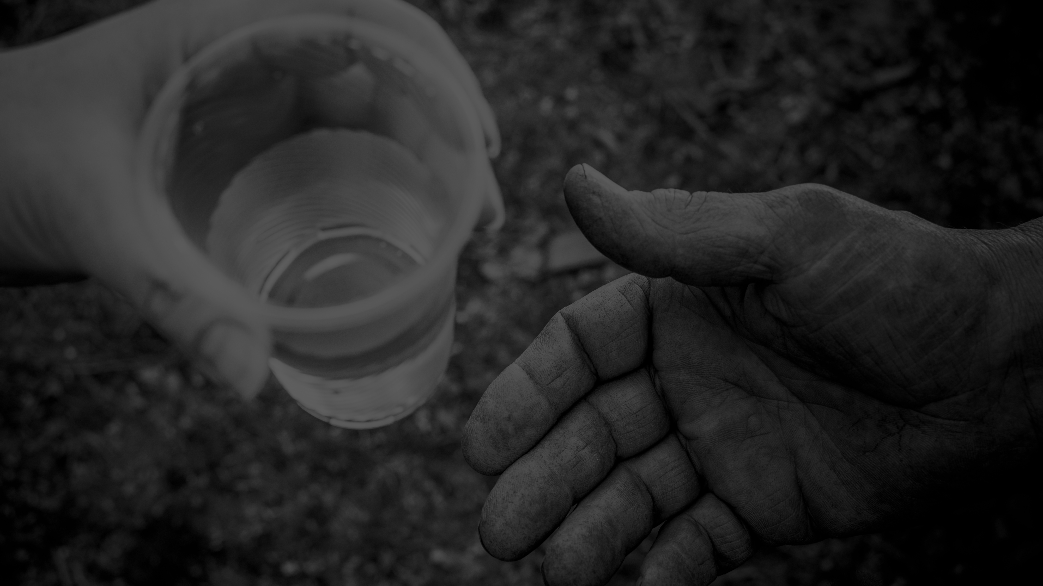
To bring the love of Jesus and hope for a new life to our homeless neighbors
MISSION

Slide 4
Every homeless neighbor— beloved, redeemed, restored
VISION
But God is so rich in mercy, and He loved us so much, that even though we were dead because of our sins, He gave us life when He raised Christ from the dead. (It is only by God’s grace that you have been saved!) EPHESIANS 2:4-5 (NLT)

Slide 5
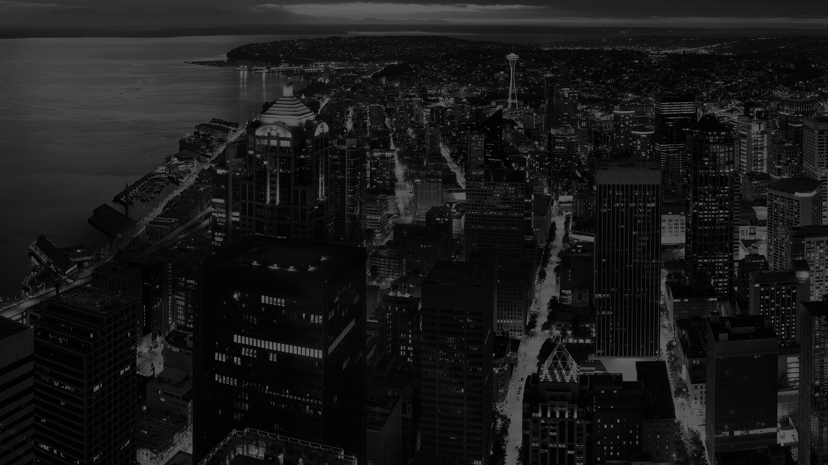
Thank You!

Slide 6
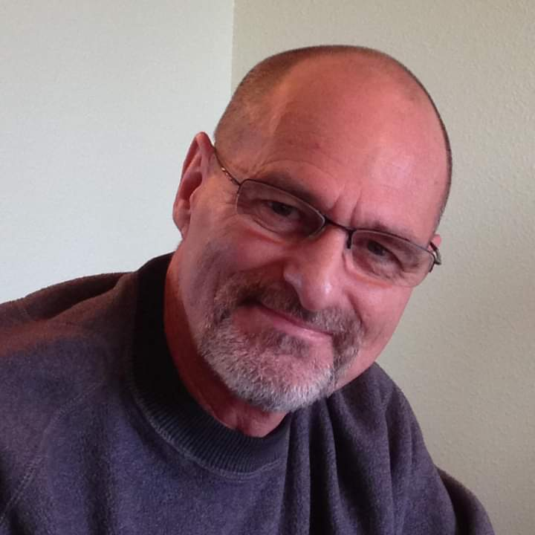
Welcome
Thank You!
Scott Cleveland
Director of the Men’s Recovery Program

Slide 7
HEADLINE
Recap
Background/Highlights
Financial Results

Slide 8
HEADLINE (logo lower right)
Recap
Background/Highlights
Financial Results

Slide 9
HEADLINE (no logo)
Recap
Background/Highlights
Financial Results

Slide 10
Optional background – small logo only

Slide 11
“Act wisely toward outsiders, making the most of the time. Let your speech always be gracious, seasoned with salt, so that you may know how you should answer each person.”
COLOSSIANS 4:5-6 CSB
Scripture
example

Slide 12
Homelessness in Seattle/King County
Chart example

Slide 13
11,199 Homeless
1,500 Youth
Half are Unsheltered
Stats
example
2,241 Families

Slide 14
Follow us
@SeattlesUGM

Slide 15
Thank You!
Thank You!

Slide 16
Thank You!
Q & A

Slide 17
Thank You!
Speaker Name

